Slide 1


A Direct Path
to the CSP: GSP & TSP
Presenter:
Title:
Company:

Slide 2



Overview
About the Graduate Safety Practitioner ® (GSP ®) and Transitional Safety Practitioner (TSP) designations
Benefits of BCSP certification
GSP/TSP requirements and application process
About the Board of Certified Safety Professionals ® (BCSP ®)
Notes:
The Graduate Safety Practitioner (GSP) is a designation available to college and university graduates from safety, health, and environmental (SH&E) degree programs which meet BCSP Qualified Academic Program (QAP) standards. The GSP program is an alternate path to the Certified Safety Professional® (CSP®) and does not replace other paths. The GSP is not a certification.
More information can be found in our Path to Success Guide (https://online.fliphtml5.com/pbcyp/feqw/#p=1)
The Transitional Safety Practitioner (TSP) is a designation available to individuals who complete a program which meets BCSP Qualified Equivalent Program (QEP) standards. The TSP program is an alternate path to the Certified Safety Professional® (CSP®) and does not replace other paths. The TSP is not a certification.
More information can be found in our Path to Success Guide (https://online.fliphtml5.com/pbcyp/feqw/#p=1)

Slide 3

What Are the
GSP/TSP Designations?
They are designations available to individuals who complete a program which meets BCSP Qualified Academic Equivalent (QAP) or Qualified Equivalent Program (QEP) standards.
  Alternate paths to the CSP
  Not a certification

Slide 4



Graduate Safety Practitioner
Designation
Available to graduates of Qualified
Academic Programs (QAPs)
Benefits:
  You meet the CSP eligibility requirement of holding a BCSP
  qualified credential, waiving the ASP and its exam
  Recognition for being on a path toward the CSP certification
  Recognition for being on a path toward the STS and STSC certifications
  Recognition for the level of preparation for professional safety practice
  A GSP digital wall certificate
  GSPs’ names and digital badges appear on the BCSP Credential
  Holder Directory
  Use of the BCSP Career Center (JOBS.BCSP.ORG) to post a resume and view career opportunities
Notes:
It is a Designation, NOT a certification
Unlike a certification, a designation:
Does not require recertification (i.e., continuing education), and
It is temporary: it is a stepping-stone to the CSP.
Scholarship: every year, the BCSP Foundation awards a $5,000 scholarship to one student enrolled full-time in an ABET accredited QAP.
About QAPs:
Curriculum mapping to ASP blueprint
QAP graduates qualify for the Graduate Safety Practitioner (GSP) designation
See next slide for more information on QAPs
Time limits:
Students graduating from a QAP must apply for the GSP within the program’s “Applicable Dates” as noted on the QAP List (found at https://www.bcsp.org/GSP). Typically a graduate must apply within one (1) year of graduation.
GSPs must have four (4) years of safety experience before applying for the CSP.
GSPs must sit for and pass the Certified Safety Professional (CSP) examination within six (6) years of the date the GSP is awarded

Slide 5

Qualified Academic
Programs (QAP)
Programs are reviewed throughout the year
and are posted to the QAP list every quarter
Curriculum mapping to ASP blueprint
QAP graduates qualify for the Graduate
Safety Practitioner (GSP) designation
The GSP Designation recognizes a graduate’s level of preparation for professional safety practice and sets them on the path toward CSP Certification
*For a current list of QAPs please visit BCSP.ORG/GSP
Notes:
A QAP is an academic degree program in safety, health and/or environmental practices meeting BCSP standards for participation and whose curriculum has been reviewed as showing a substantial match with the Associate Safety Professional (ASP).
Our list of current QAPs updates quarterly, as we regularly receive review request from prospective programs, so check our website often for updates!
Benefits of being a QAP
Being a GSP QAP distinguishes your SH&E program from other programs, recognizing graduates' accomplishments with a path to professional certification.
BCSP gives special recognition to QAPs in our Academic Database.
University faculty teaching SH&E courses may qualify for a free ASP and CSP application and free exams.
QAPs are eligible for a grant of up to $10,000 toward full accreditation or reaccreditation by the Accreditation Board for Engineering and Technology (ABET)
The BCSP Foundation provides ABET/AABI accredited QAPs with $5,000 scholarships for their students.

Slide 6


Apply Online: BCSP.ORG
Apply online at BCSP.ORG
  Upload a conferred transcript
QAP graduates must apply within one (1) year of graduation.*
GSPs must sit for and pass the CSP examination within six (6) years of the date the GSP is awarded.
*Must apply within the program’s “Applicable Dates” as noted on the QAP List
Notes:
It is a Designation, NOT a certification
Unlike a certification, it is a designation:
Does not require recertification (i.e. continuing education), and
It is temporary: it is a stepping stone to the CSP.
The GSP can only be held for a maximum of 6 years before it expires. Therefore, GSPs should be working to obtain the experience requirements for the CSP and sit for the exam within the 6 years they can hold the GSP.
Students graduating from a QAP must apply for the GSP within the program’s “Applicable Dates” as listed on the QAP list, typically one (1) year from graduation. to. Click on the "My Profile" button at BCSP.ORG and create a profile to begin.
Note: The GSP application is free and there is a $140 annual fee to maintain the GSP designation.

Slide 7


Transitional Safety Practitioner
Designation
Available to individuals of Qualified Equivalent
Programs (QEPs)
Benefits:
  You meet the CSP eligibility requirement of holding a BCSP qualified credential, waiving the ASP and its exam
  Recognition for being on a path toward the CSP certification
  Recognition for the level of preparation for professional safety practice
  A TSP digital wall certificate
  TSPs’ names and digital badges appear on the BCSP Credential Holder Directory.
  Use of the BCSP Career Center (jobs.bcsp.org) to post a resume and view career opportunities
Notes:
It is a Designation, NOT a certification
Unlike a certification, a designation:
Does not require recertification (i.e. continuing education), and
It is temporary: it is a stepping stone to the CSP.
Individuals from a QEP must apply for the TSP within the program’s “Applicable Dates” as listed on the QEP list, typically one (1) year from graduation. . Click on the "My Profile" button at www.bcsp.org and create a profile to begin.
TSP Time Limit
TSPs must apply for and pass the Certified Safety Professional (CSP) examination within six (6) years of the date the TSP is awarded.

Slide 8


Qualified Equivalent Programs (QEP)
Eligibility:
Curriculum-based certificate, diploma
Substantial match to ASP blueprint
QEP graduates qualify for the TSP
The TSP designation recognizes an individual’s level of preparation for professional safety practice and sets him/her on the path toward CSP certification.
*For a current list of QEPs please visit BCSP.ORG/TSP
Notes:
What are the benefits of becoming a QEP?
-Being a QEP distinguishes your SH&E program from other programs.
-BCSP gives special recognition to QEPs on our website.
-Individuals who complete your QEP program and apply for the TSP designation are provided additional benefits and recognition for their advancement in safety practice.
Note our list of current QEPs updates frequently, as we regularly get application request from prospective programs, so check our website often for updates!

Slide 9
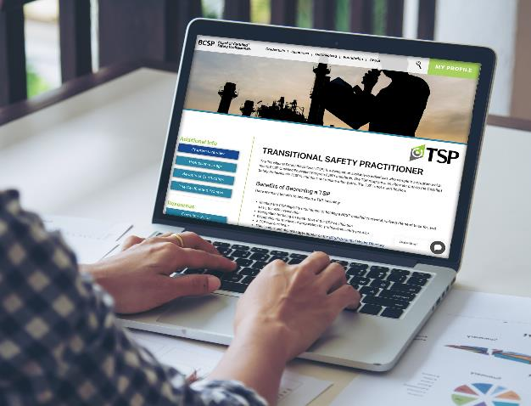

Apply Online: BCSP.ORG
Apply online at BCSP.ORG
  Upload a copy of the official credential and the date obtained
Individuals from a QEP must apply within the program’s “Applicable Dates” as listed on the QEP list, typically within one (1) year of graduation.*
TSPs must have a bachelor’s degree and four years of safety experience before applying for the CSP. They must sit for and pass the CSP examination within six (6) years of the date the TSP is awarded.
Notes:
It is a Designation, NOT a certification
Unlike a certification, a designation:
Does not require recertification (i.e. continuing education), and
It is temporary: it is a stepping stone to the CSP.
The TSP can only be held for a maximum of 6 years before it expires. Therefore, TSPs should be working to obtain the experience requirements for the CSP and sit for the exam within the 6 years they can hold the TSP.
Note: There is a $140 annual fee to maintain the TSP designation.

Slide 10








BCSP Certifications
Certified Safety
Professional ®
Associate Safety
Professional ®
Safety Management Specialist ®
Occupational Hygiene and
Safety Technician™
Construction Health and
Safety Technician ®
Safety Trained Supervisor ®
Safety Trained Supervisor Construction ®
Certified Instructional Trainer
Notes:
Headquartered in Indianapolis, IN, USA, the Board of Certified Safety Professionals (BCSP) is a not-for-profit corporation recognized as a leader in high-quality, accredited credentialing for safety, health, and environmental (SH&E) practitioners.
BCSP currently offers 8 certifications and recently celebrated 50 years of excellence in safety credentialing. These certifications are designed to set and certify technical competency criteria for SH&E practitioners worldwide. Together, we can create a safer world through safety, health, and environmental leadership.

Slide 11


Eligibility Requirements
Minimum Academic Requirement
  Accredited* bachelor’s degree in any field
Experience Requirement
At least four (4) years of experience where safety is at least 50%,
preventative, professional level with breadth and depth of safety duties
Examination(s)
Pass the ASP or hold an approved equivalent
Ethics
Commitment to the BCSP Code of Ethics
*Degree Programs and School must be accredited. An accredited school is one that is recognized by the US Department of Education or the Council of Higher Education Accreditation (CHEA).
*When applying for the CSP with a degree from a college outside the United States, that degree will be evaluated for US equivalency.
Notes:
*Degree Programs and School must be accredited. An accredited school is one that is recognized by the U.S. Department of Education or the Council of Higher Education Accreditation (CHEA).
*Degrees from colleges and universities outside the United States will be evaluated for US equivalency.

Slide 12

Benefits of Certification
ACCOMPLISHMENT
VALIDATION
OPPORTUNITIES
COMPETITION
RECOGNITION
DEMONSTRATES THAT SAFETY IS EVERYBODY’S JOB
Notes:
Hiring Preferences and Salary Increases: Advertisements for safety professionals often identify the CSP certification or other BCSP credentials as a desired or required qualification along with education and experience. Human resource managers and those hiring people for government positions depend on professional certification to ensure candidates have met minimum qualifications.
Enhance Your Self-Esteem: The most frequent reported value derived from achieving a BCSP credential is increased self-esteem and personal satisfaction. Most newly-certified individuals report that achieving their certification increases their personal worth. A major factor is having met standards established by peers for professional safety practice. It indicates that you have risen above the competition because you have been evaluated by professional peers against those standards.
Share Your Knowledge for Professional Safety Practice: Having achieved a certification shows you have mastered the core knowledge required for professional safety practice. The Safety Salary Survey shows that the certification process provided them with appropriate qualifications in the field. The certification did what it is intended to do - ensured the knowledge necessary for practice.
Gain an Advantage Over Your Peers: Due to the high quality of BCSP credentials, as demonstrated by its compliance with national and/or internationally recognized standards for certification of persons, most holding a BCSP credential have created an edge for themselves. As recognition for BCSP credentials grow among employers, government agencies, peers, and the public; those holding one have a competitive advantage for safety positions and assignments.
Personal accomplishment
Validation of competency in safety management
Expands opportunities for qualified safety practitioners
More competitive in obtaining jobs, promotions
Recognizes contributions of non full-time safety practitioners
Demonstrates that safety is everybody’s job
Certification also reflects an individuals:
* Dedication to their colleagues’ safety
* Responsibility as a leader
* Desire for accountability

Slide 13

Benefits of Certification
Employers and Owners
Helpful in selecting qualified safety professional
Improves safety in the workplace through increased competence and confidence
Increases public confidence in the employer’s safety program
Enhances profitability and quality by reducing accidents, illnesses, and insurance claims
Notes:
Achieving certification is important because it demonstrates your level of competency in the safety, health, and environmental (SH&E) fields. Certifications advance safety professionalism, and they provide a competitive advantage for the certificate holder. It’s also important to remember that credentials like the ones BCSP offers demonstrate credibility in your chosen field, and they set the standard for safety that helps keep everyone safe in the workplace. A BCSP certification can also lead to better pay and job mobility, as possessing a greater knowledge base and having more experience can lead to better careers in safety.

Slide 14
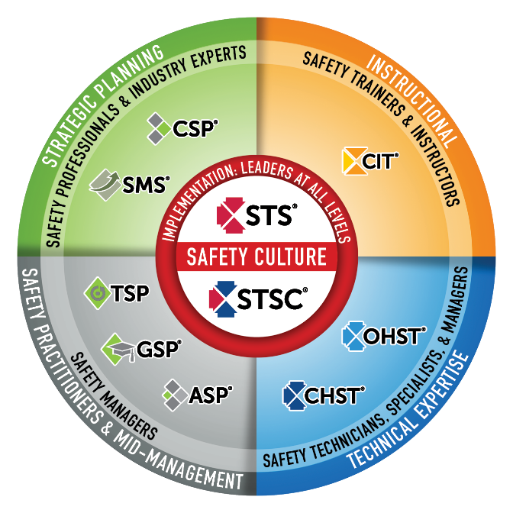

Safety Culture
BCSP fulfills industry and global demand
for validating highly competent safety practitioners with varying amounts of formal education and significant amounts of experience.
BCSP certifications create a unified safety culture by setting baseline competencies of safety knowledge and skills throughout the organization.
The best safety cultures require safety competency across the organization and also value safety leadership at all levels.
Notes:
BCSP Safety Certification Continuum
This graphic is a good way to convey the differences between BCSP’s certifications. It shows the correlation between each and in which fields the credentials are most useful.
BCSP credentials create a unified safety culture by setting baseline competencies of safety knowledge and skills throughout organizations.
The need for safety exists at all levels of an organization. The best safety cultures require safety competency across the organization and value safety leadership at all levels.

Slide 15

The Certification Process
Notes:
All BCSP certifications are different, but the process of achieving and maintaining them is the same. This graphic offers a quick overview of the process. A greater explanation can be found in the Complete Guide (https://online.fliphtml5.com/pbcyp/ijfs)

Slide 16


About BCSP:
Credentialing Leader
History of excellence
Exceptional standards of governance
Integrity in exam process
International recognition
Maintains highest standards of accreditation
50,000+ active certifications/designations
in 108 countries
Notes:
BCSP is recognized as the leader in high-quality credentialing for safety, health, and environmental practitioners.
BCSP establishes standards for and verifies competency in professional safety practices and evaluates certificants for compliance with recertification requirements.
One of the longest-running professional credentialing bodies for SH&E professionals in the world
CRSP- 1976
IOSH didn’t begin issuing Chartered S&H Practitioner Status until 2005
Only ABIH is older than us (first CIHs issued in 1952)
History
Established in 1969
More than 58,000 credential holders across 108 countries since 1969
Not-For-Profit — headquartered in Indianapolis, IN
Mission-driven: We inspire and develop leaders in safety, health, and environmental practice through globally accredited certification; enhancing careers, advancing the profession, protecting people
Vision: A safer world through safety, health, and environmental leadership.
Standards of Governance
9 - 14 Member Board of Directors
8 Sponsorship Organizations to ensure governance of BCSP includes broad representation from across the safety profession
AIHA, ASSP, NSC, NFPA, SFPE (Society of Fire Protection Engineers), IISE, ISSS, NESHTA
Integrity in Exam Process
Psychometric process:
Ensures all exams meet the highest standards when it comes to accurately reflecting the most relevant tasks, knowledge and skills required for current professional safety practice;
Ensures items are well-written, extensively reviewed, are reliable and valid
Ensures regular review occurs (revalidation)- occurs every 4-5 years
Widespread recognition
BCSP is recognized as the leader in high-quality credentialing for safety, health, and environmental practitioners.
The CSP is the “gold standard” worldwide
BCSP is actively involved internationally with defining and expanding the safety profession (will talk more about our relationships/collaborations with international safety organizations later, such as INSHPO)
Recognized by international bodies:
UN (Special Consultative Status with ECOSOC)
ISO
International safety certification boards
Accreditation: and not just any accreditation; BCSP follows the highest standards for accreditation, as set by the ISO
58,496 active certifications/designations in 108 countries around the world (as of November 30, 2021).

Slide 17

We Are BCSP: Inspiring a Safer World

Slide 18
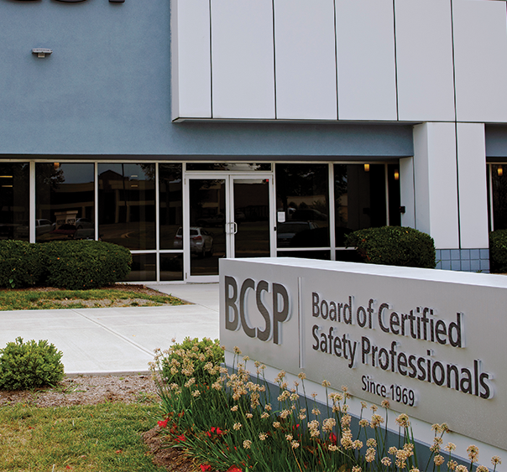
About BCSP
Established in 1969
Not-For-Profit —
headquartered in Indianapolis, IN
9 – 14 Directors on the Board
Not a membership organization
Internationally Recognized
Notes:
Headquartered in Indianapolis, IN, USA, the Board of Certified Safety Professionals (BCSP) is a not-for-profit corporation recognized as a leader in high-quality, accredited credentialing for safety, health, and environmental (SH&E) practitioners.
BCSP currently offers 8 certifications and recently celebrated 50 years of excellence in safety credentialing. These certifications are designed to set and certify technical competency criteria for SH&E practitioners worldwide. Together, we can create a safer world through safety, health, and environmental leadership.

Slide 19


About BCSP
MISSION
We inspire and develop leaders in, health, and environmental
practice through globally accredited certification; enhancing
careers, advancing the profession, protecting people.
VISION
A safer world through
safety, health, and
environmental leadership.
CORE VALUES
BCSP – Be respectful, Create positive cultures,
Serve as leaders, Protect others
Notes:
Since 1969, the Board of Certified Safety Professionals (BCSP) has been setting and certifying the technical competency criteria for safety, health, and environmental practitioners.
In that time, many joined us as pioneers, improving safety practice by meeting the challenge of achieving and maintaining quality, accredited safety certification—The Gold Standard.
As BCSP begins the second half of our first century as an organization, what we have built has rewarded us with many new and exciting opportunities to advance safety. As we head into the future, we will ensure no one is left behind. BCSP will continue to create the path forward.

Slide 20
About BCSP:
8 Endorsing Organizations
AIHA® - American Industrial Hygiene Association® (1974)
ASSP - American Society of Safety Professionals (1974)
IISE - Institute of Industrial and Systems Engineers (1994)
ISSS - International System Safety Society (1977)
NESHTA - National Environmental, Safety and Health Training Association (2012)
NFPA - National Fire Protection Association (2007)
NSC - National Safety Council (1994)
SFPE - Society of Fire Protection Engineers (1984)
Notes:
These organizations ensure that governance of BCSP includes broad representation from across the safety profession.
Affiliated endorsing organizations nominate individuals to serve on the BCSP Board of Directors. These organizations do not provide funding or support to BCSP or its operations. They do provide their members with a variety of member services, including journals, conferences, continuing education courses, books, and many other valuable services for safety professionals.
The current affiliated endorsing organizations are listed along with the year in which they began their participation with BCSP.

Slide 21


Now Offering an
Exam Bundle!
REDUCE STRESS
WITH A 2ND CHANCE TEST!
Exam bundles include an examination authorization, an online
self-assessment, and a second exam attempt if the first is unsuccessful for one reduced price.
Apply Today @
Notes:
Applicants who are exam-eligible may select "Purchase Exam" and choose to buy an exam bundle.
CSP, SMS, ASP: Exam $350. Bundle $600.
OHST, CHST: Exam $300. Bundle $550.
STS, STSC: Exam $185. Bundle $325.
CIT: Exam $300. Bundle $500
-Each examination authorization is good for an exam sitting, is non-transferable and non-refundable.
-You must have at least thirteen (13) weeks left on your eligibility time clock to purchase the Exam Bundle.
-Applicants must wait a six (6) week period between exam attempts if a second attempt is needed.

Slide 22


Training from the source
Your path to success
Industry leading instructors
examCORE.ORG
Notes:
CSP, SMS, ASP, OHST, and CHST available now. $999 for 6 months access
Each training includes: 40+ subject areas, 1000+ questions
STS and STS available now. $499 for 6 months access.
Each training includes: 30+ subject areas, and 500+ questions
CIT available now. $699 for 6 months access.
Includes: 30+ subject areas, and 700+ questions
ASP + CSP examCORE Connect gives access to both training courses. $1,899 for 9 months access. Connect training includes: 40+ subject areas, 2,000+ questions

Slide 23



Questions?

Slide 24
Thank you!
Presenter:
Title:
Company:

